Slide 1
Money Mate :The Futuristic Currency Converter for your Desktop

Slide 2
Abstract
In finance,an exchange rate between two currencies is the rate at which one currency will be exchanged for another.
It is a useful tool which gives us the value of certain amount of one currency to be converted in to a different currency.
It is also regarded as the value of one country’s currency in terms of another currency.
In this project we are going to display a window in which currency options are given and the conversion value will be displayed.

Slide 3
Introduction
Currency converter is a tool used to convert one country’s currency to another.
In this project by the knowledge of usage of currency converter a program is designed in java language.
In this Currency Converter application, it is going to display an application where u can choose to display the converter or the exchange rate of one currency with all other currencies in the form of table. In the converter u are given a choice to choose two currency names from the list of currency names displayed.

Slide 4
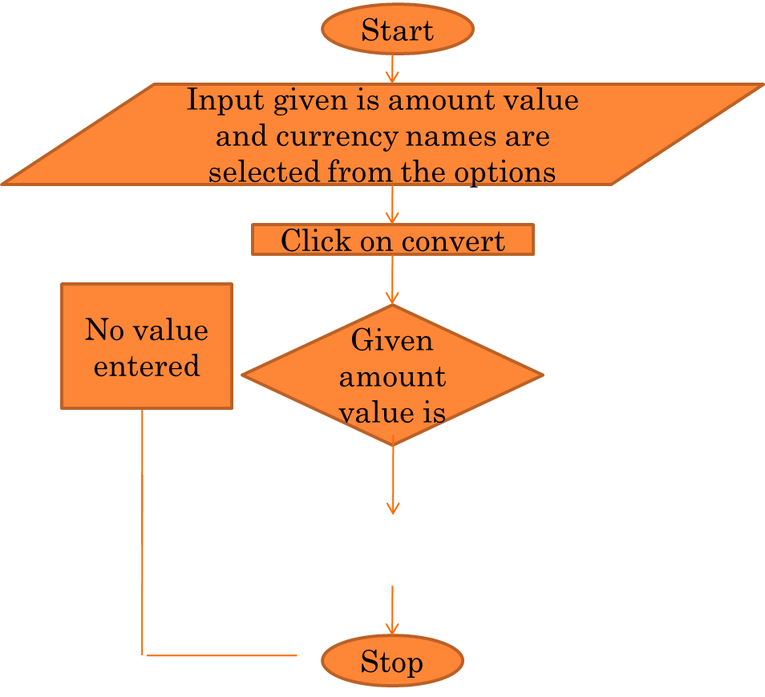
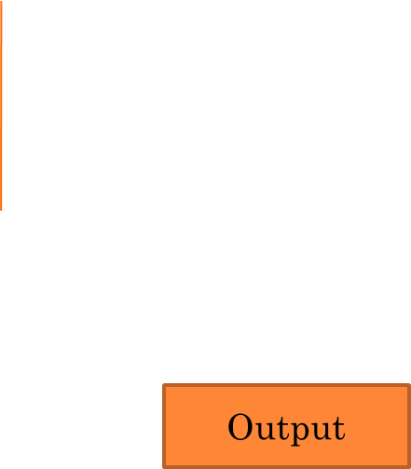
FLOW CHART

Slide 5
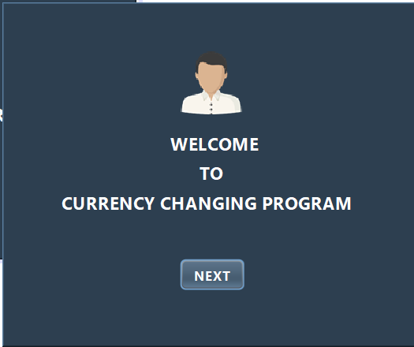
SCREEN SHOTS

Slide 6
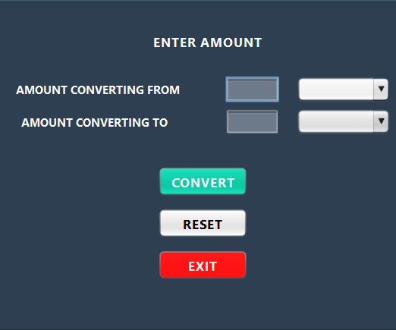
WHEN USER CLICK NEXT BUTTON

Slide 7
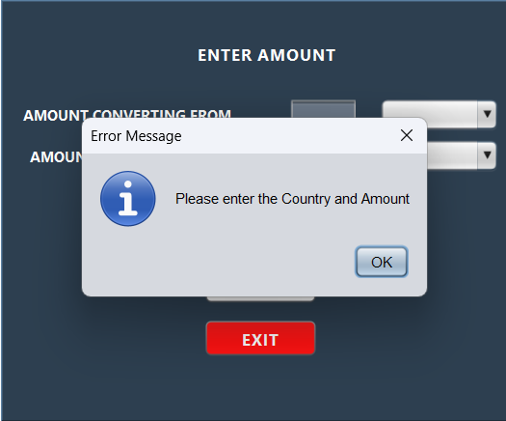

Slide 8
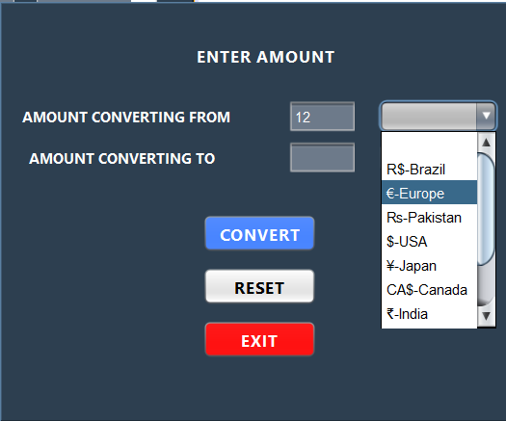

Slide 9
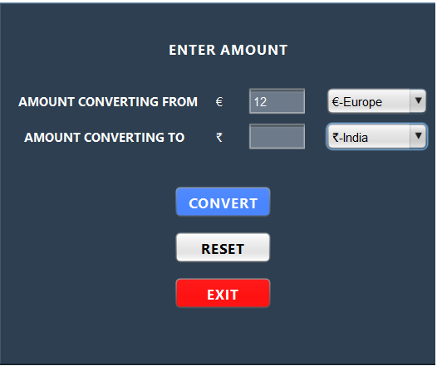

Slide 10
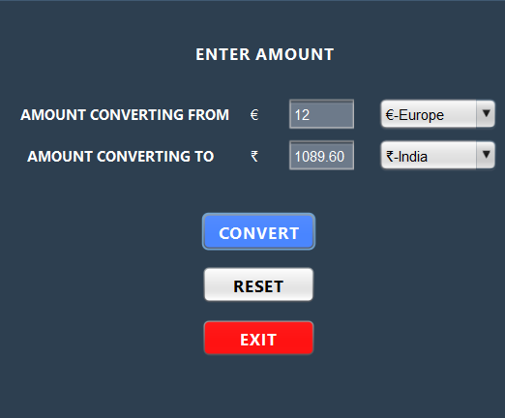

Slide 11
CONCLUSION
Therefore , currency converter is developed and is used for knowing the currency’s value. It can be further developed by including more currency options. A currency converter can help you do this by giving you up-to-date exchange rates.
• Send money to another country: If you need to send money to another country, a currency converter can help you calculate the cost of the transfer.
• Track the value of your investments: If you have investments in foreign currencies, a currency converter can help you track the value of your investments in real time.
• Compare exchange rates: When you are looking for the best exchange rate, it's important to compare rates from different providers. A currency converter can help you do this by providing you with a list of exchange rates from different providers.

